Slide 1
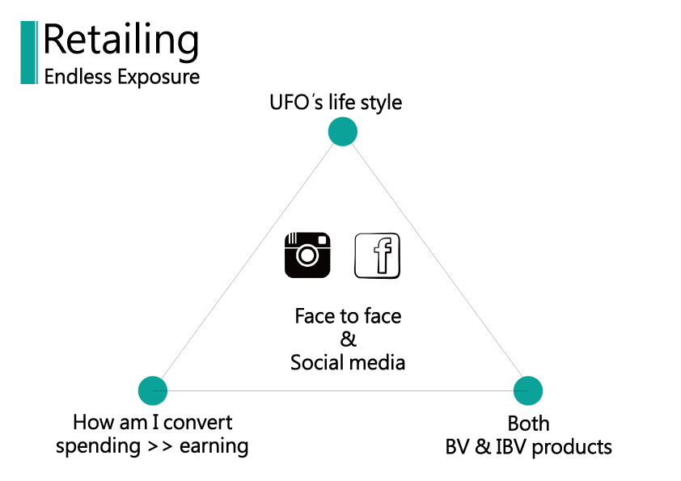

Slide 2
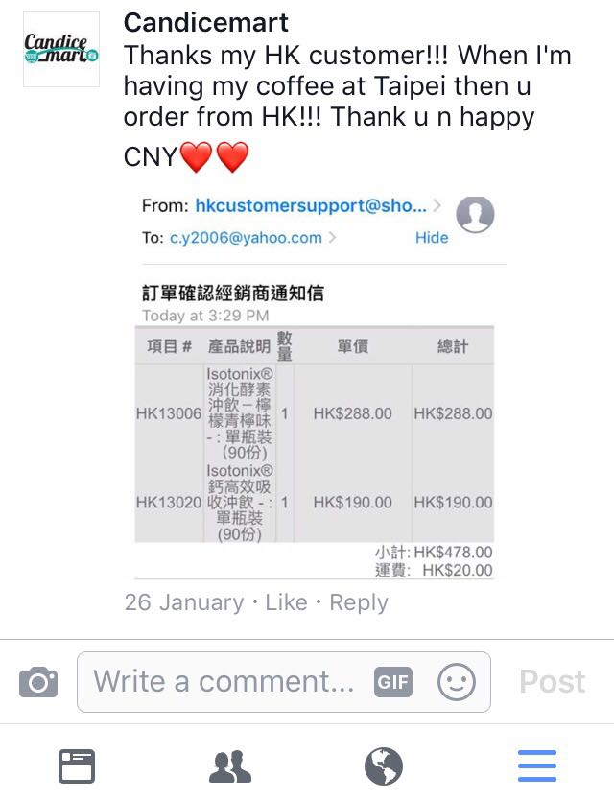
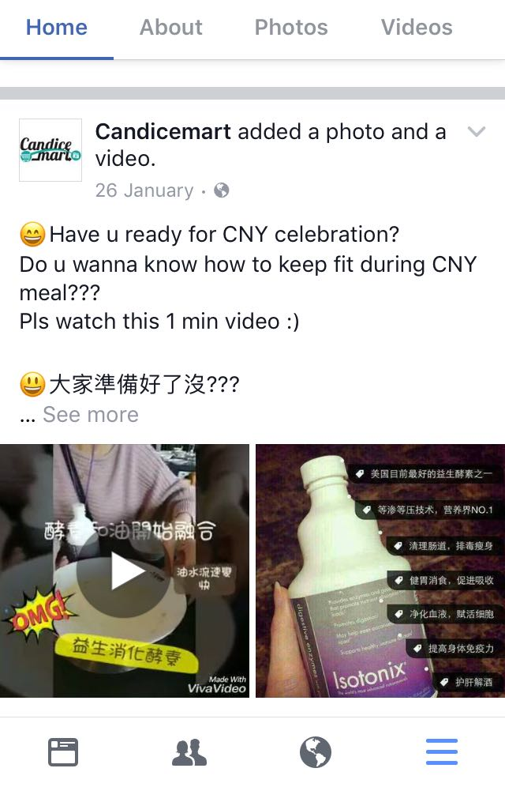

Slide 4
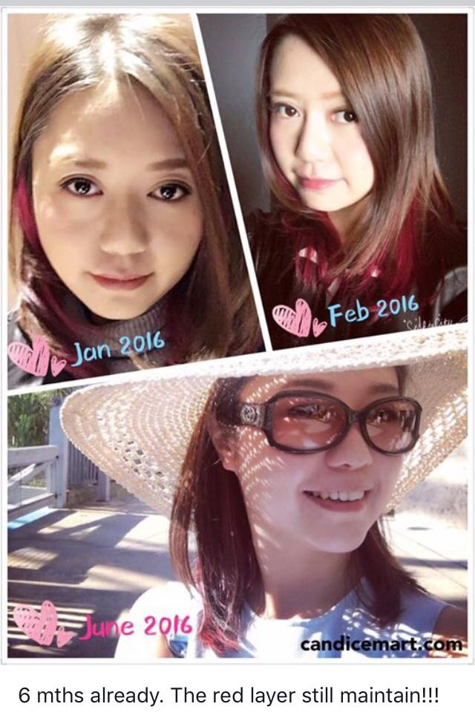
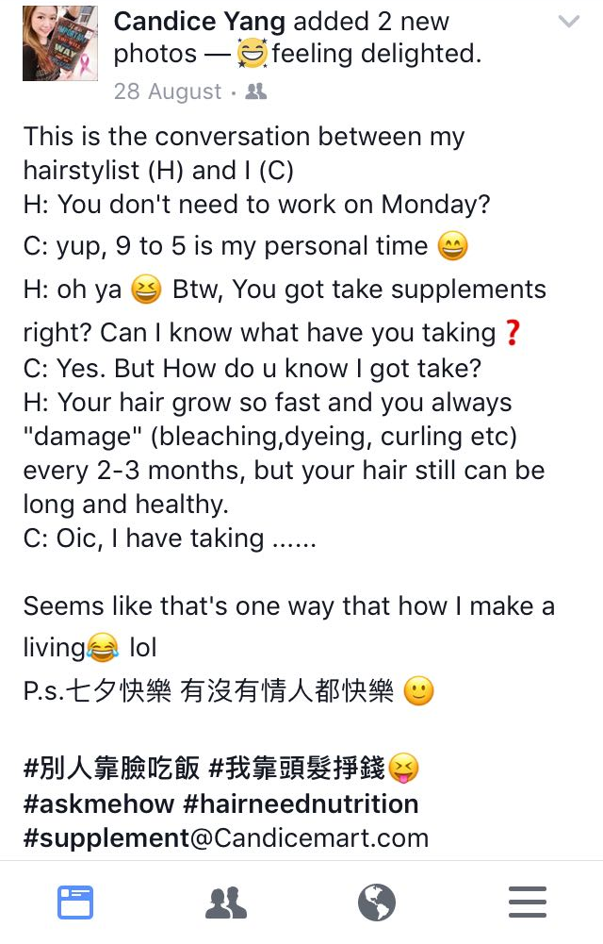

Slide 5
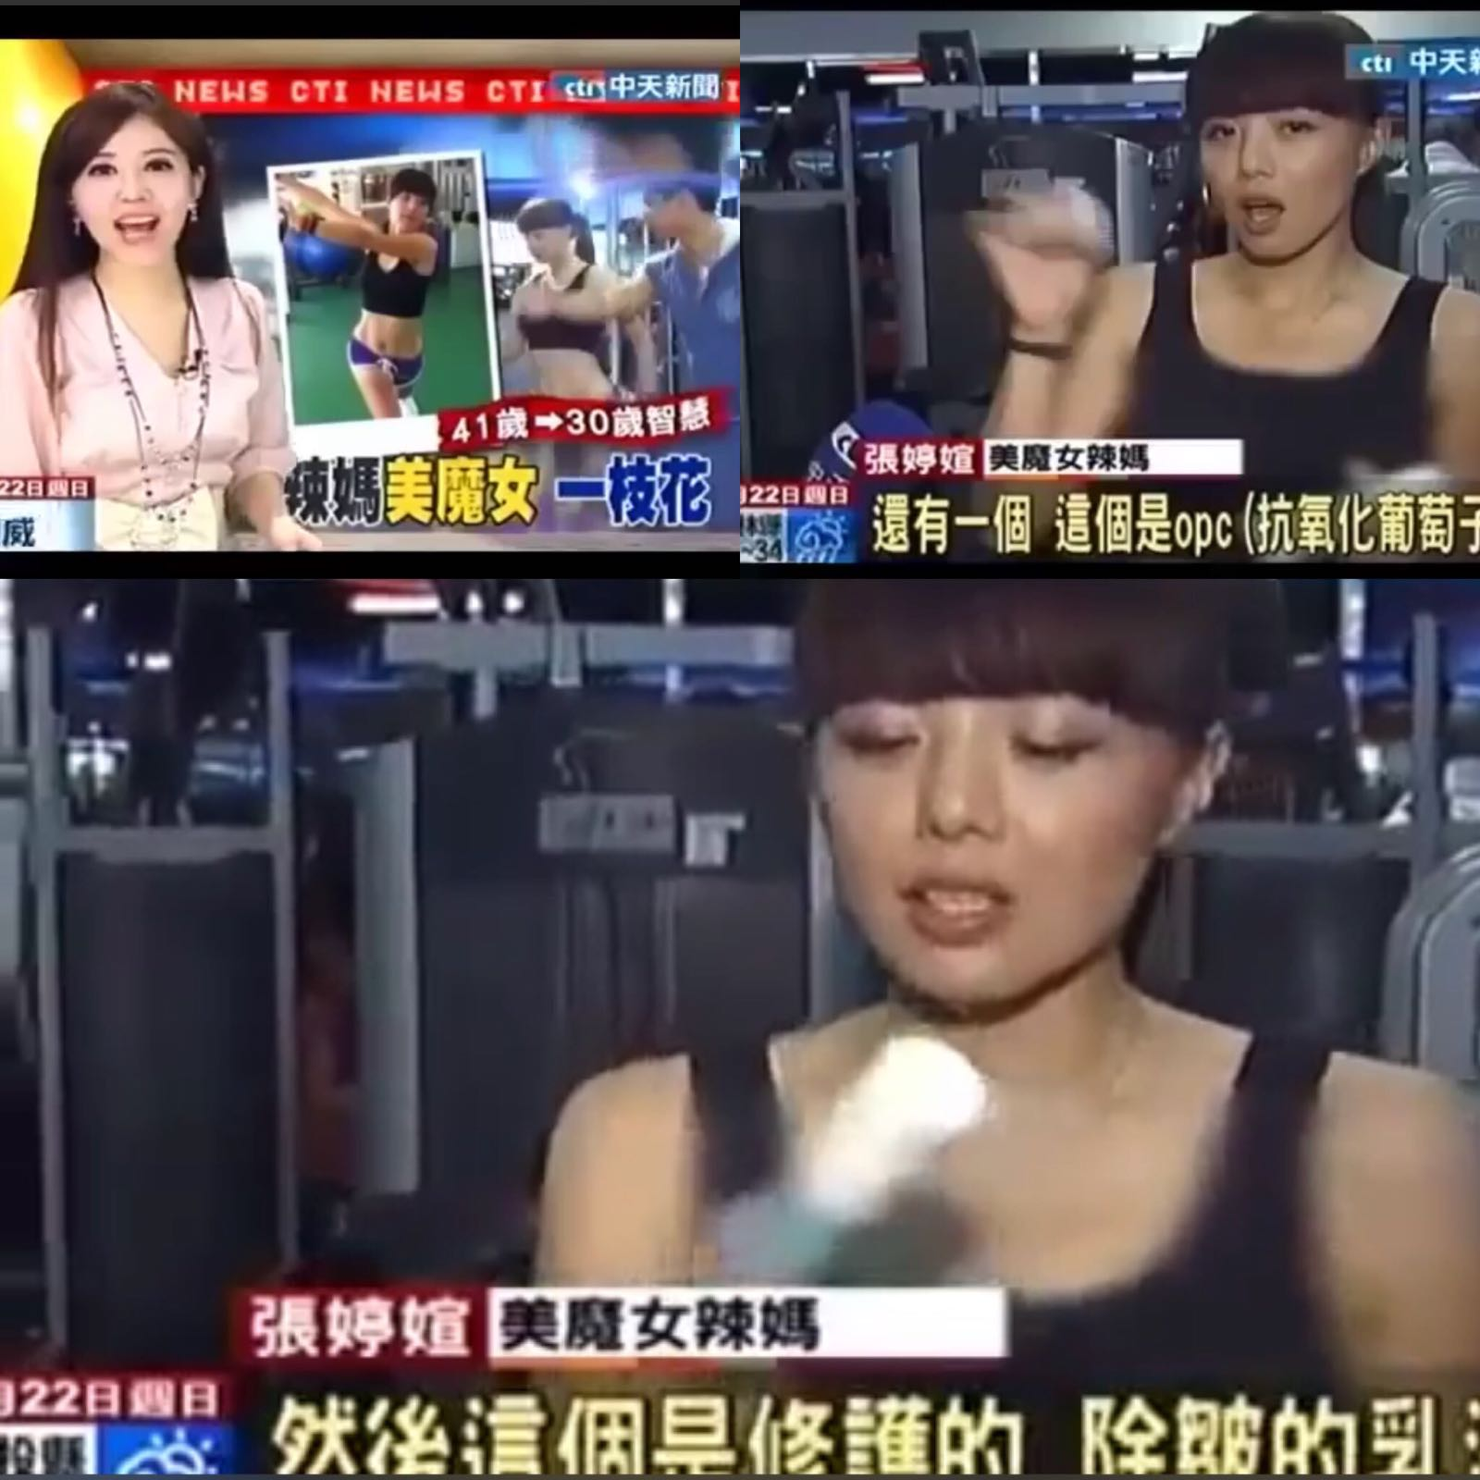

Slide 6
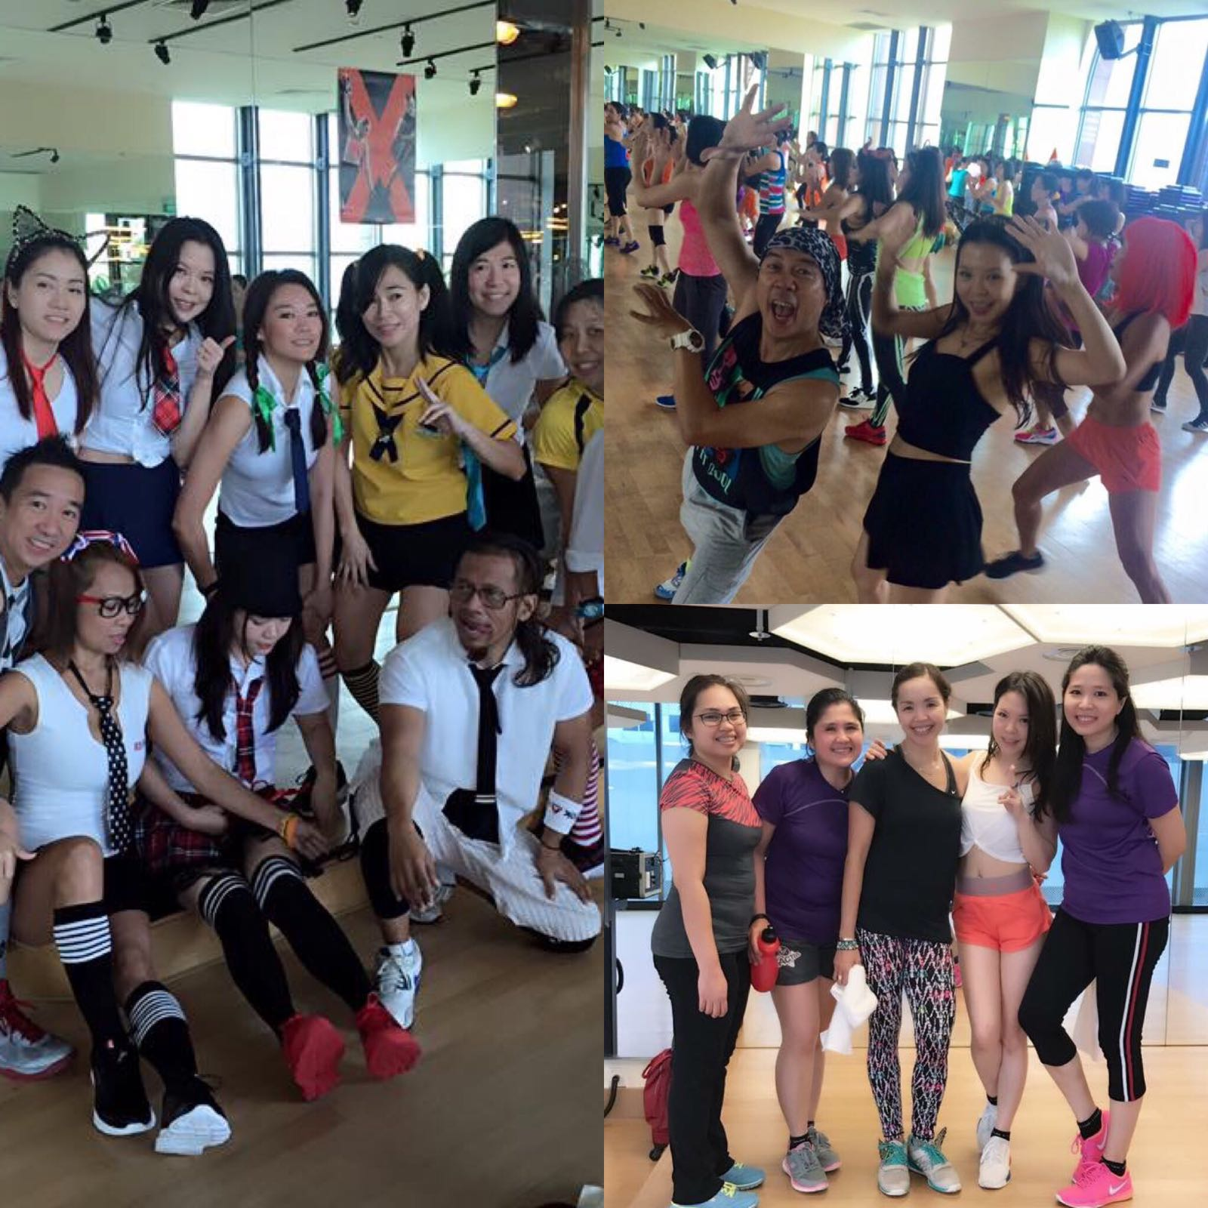

Slide 7
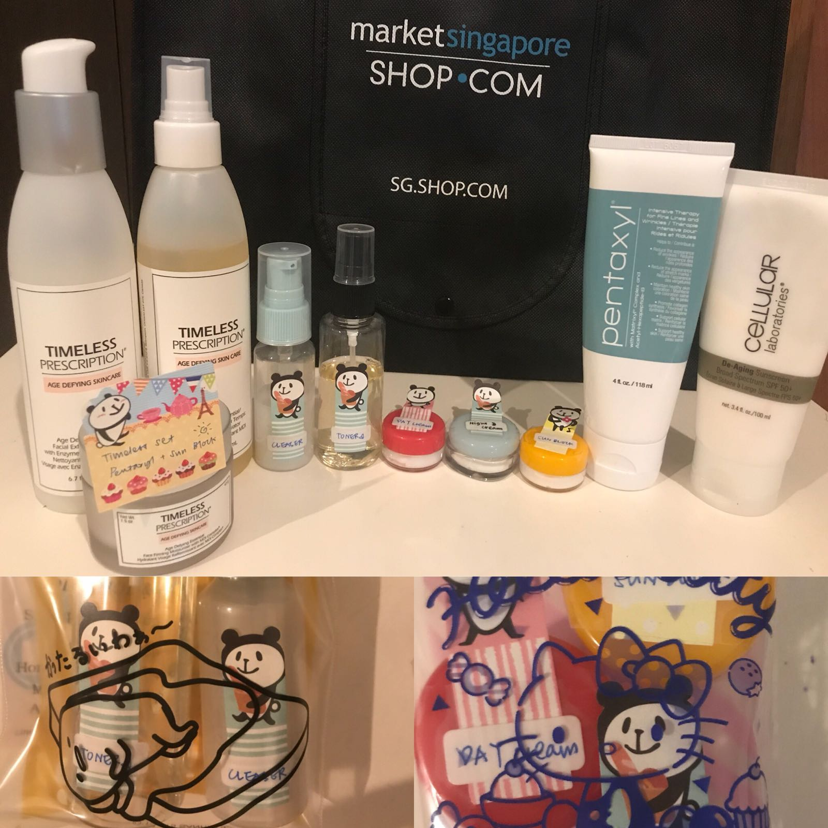
PRODUCT SAMPLES

Slide 8
WHAT I LIKE ABOUT THIS BUSINESS….
IS THAT I SHARE ANYTIME, ANYWHERE…
EVEN WHEN I’M TRAVELLING.

Slide 9
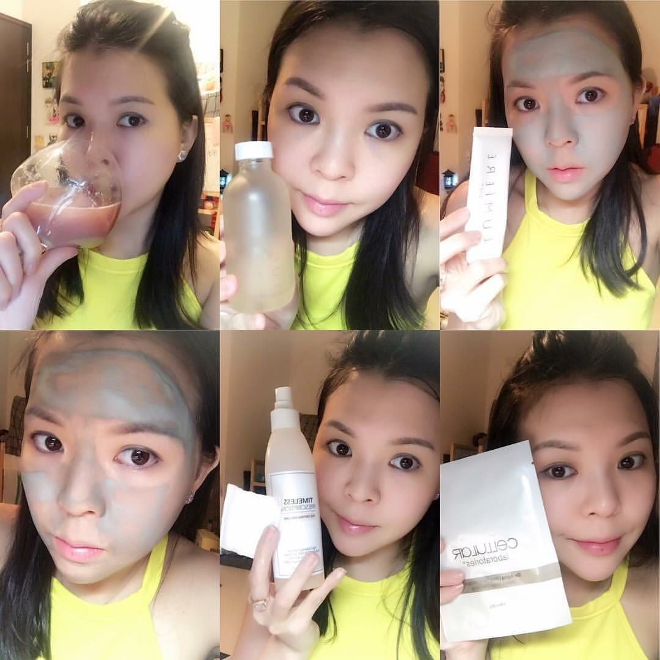
BE THE PRODUCT
OF THE PRODUCT

Slide 10
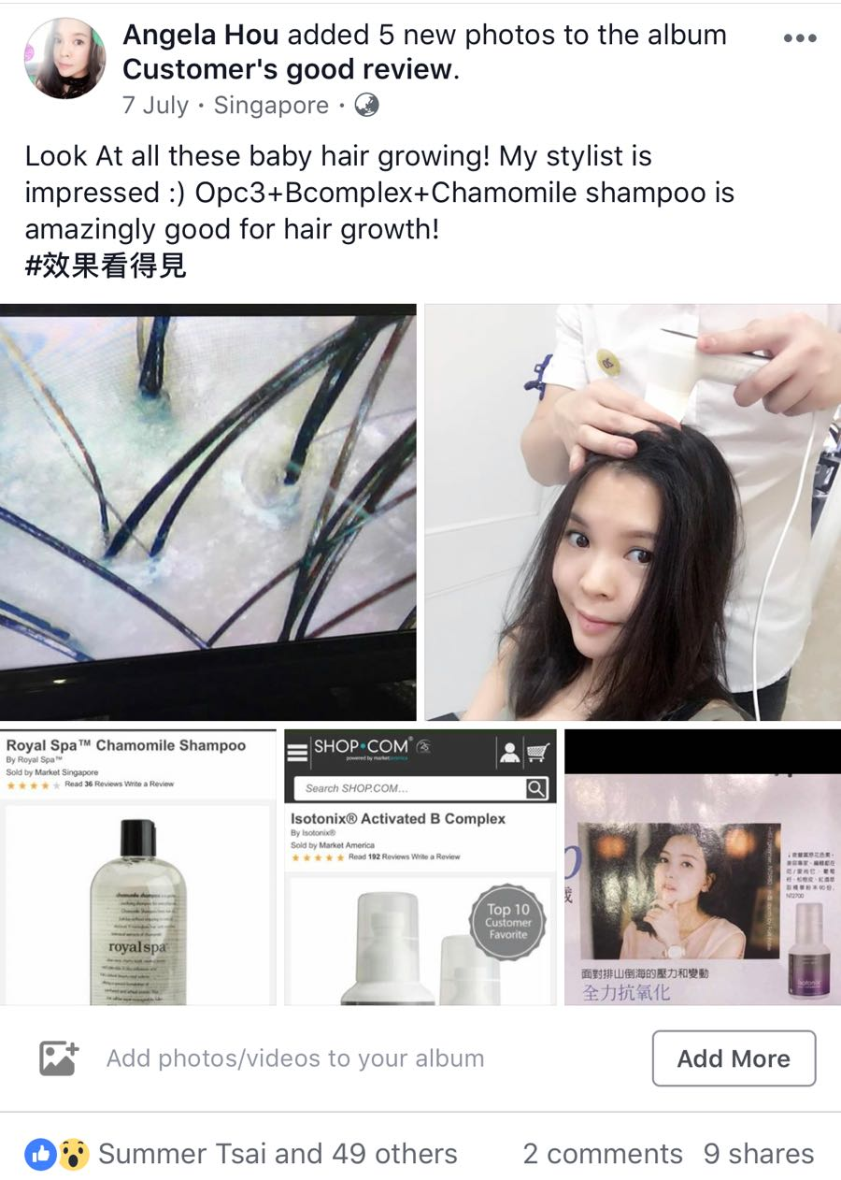
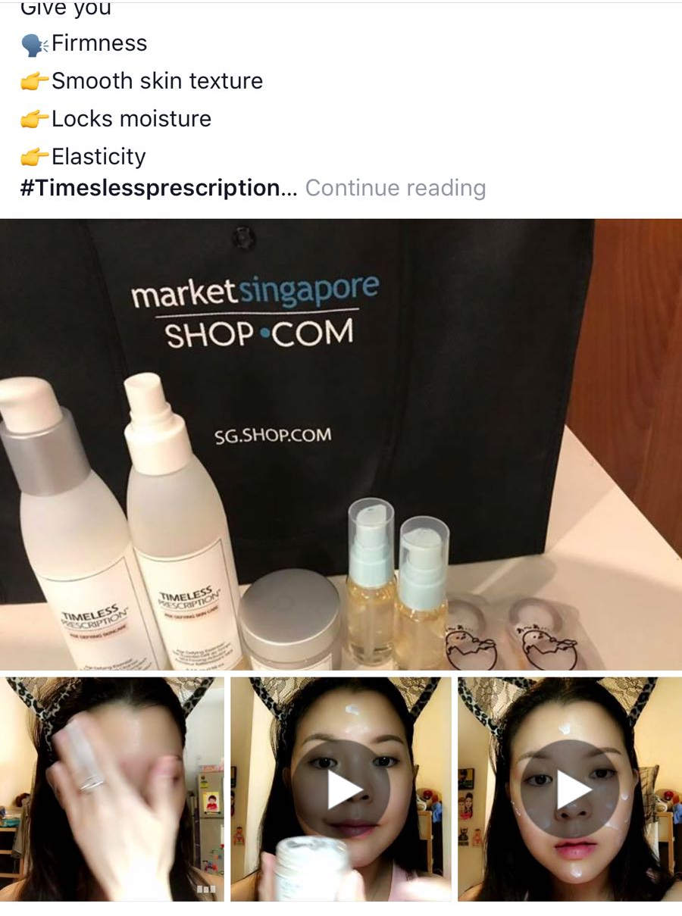
USING SOCIAL MEDIA AS A TOOL

Slide 11
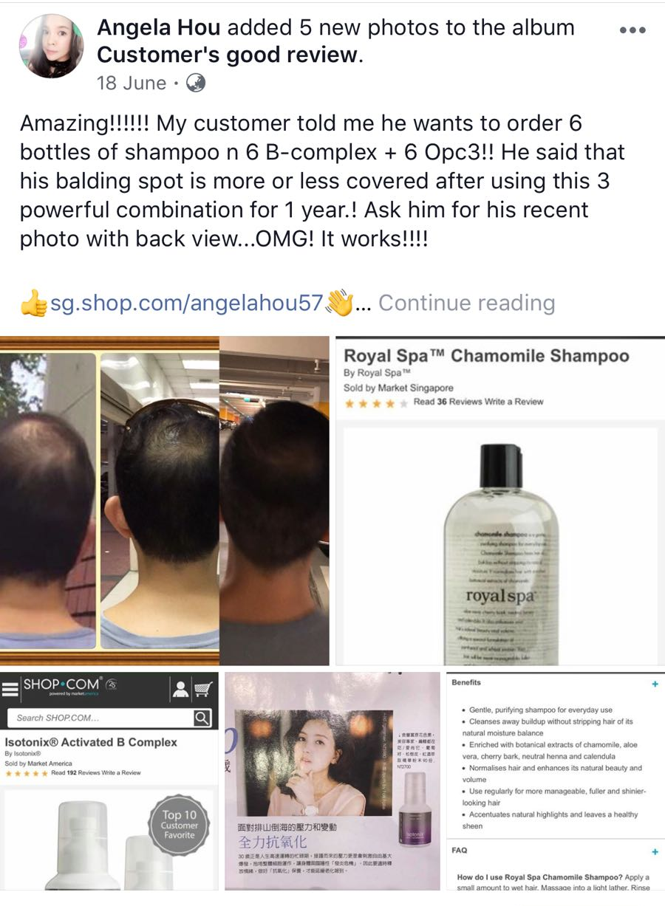
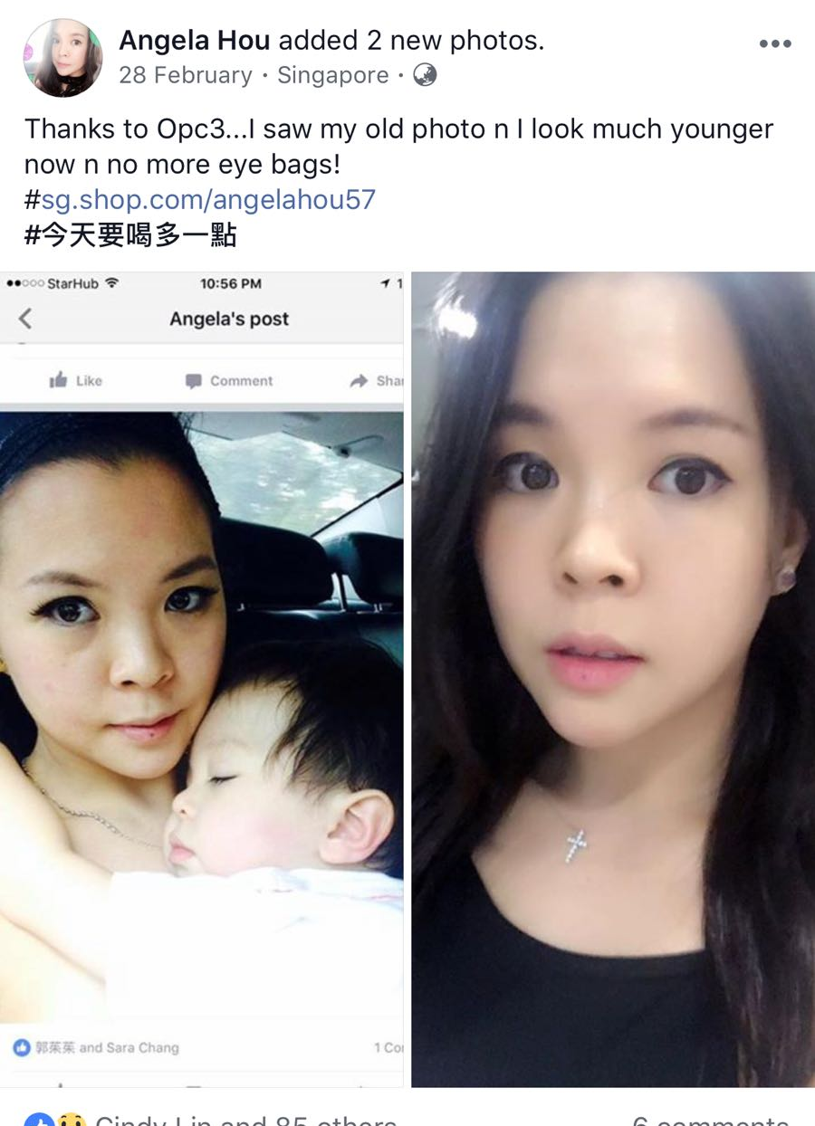
TESTIMONIAL SHARING

Slide 12
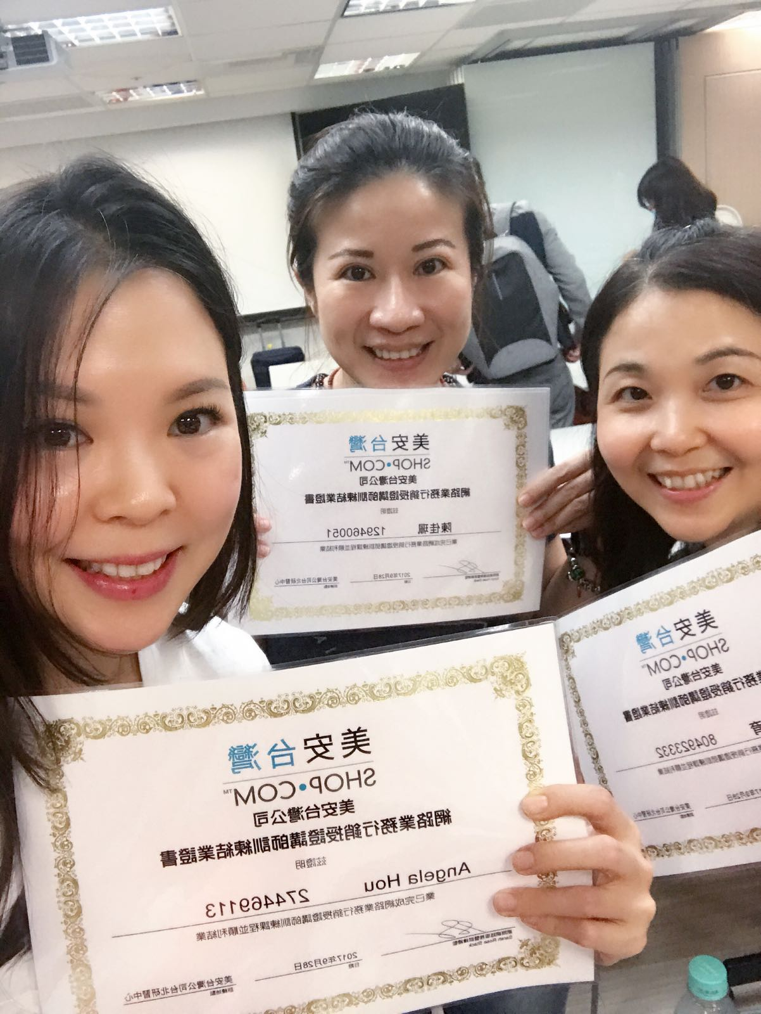
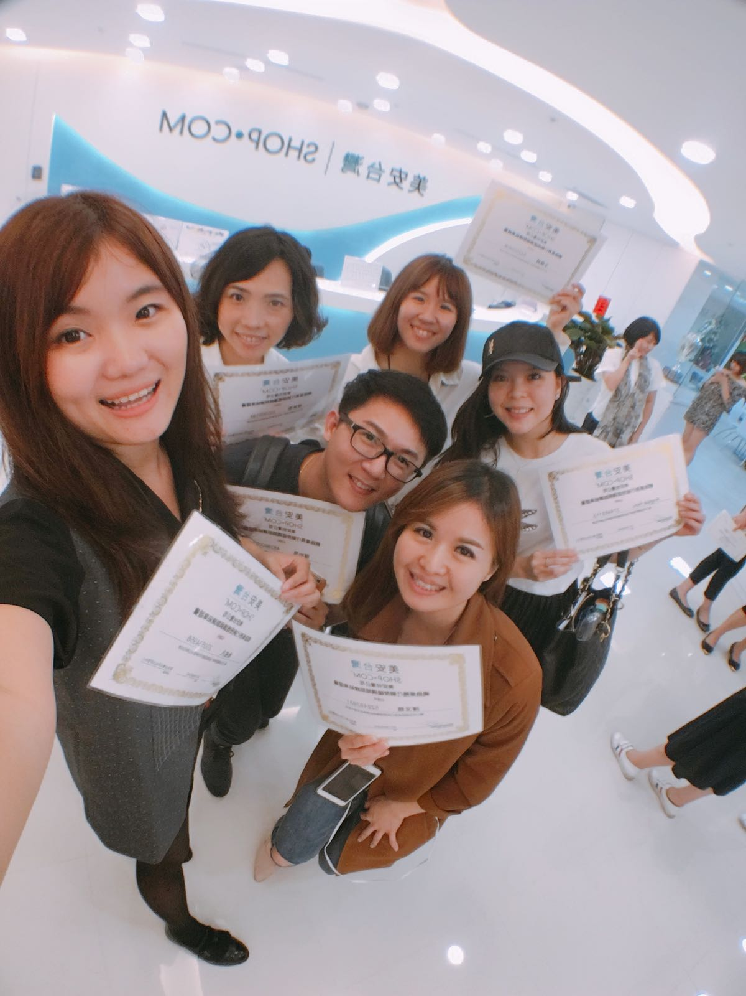
ISM CERTIFIED TRAINER

Slide 14
KNOWLEDGE IS POWER

